Slide 1

Chapter 10 – part I

Slide 2
OUTLINE
  Torque and angular acceleration.
  Combining rotation and translation.
  Work and power in rotational motion.

Slide 3
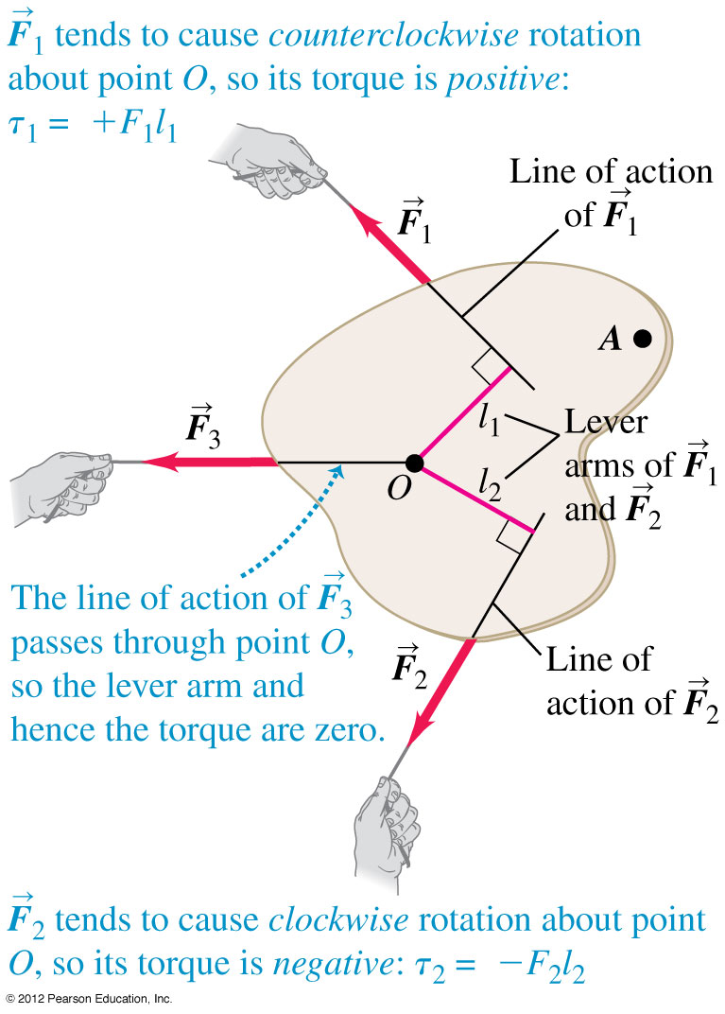
Torque
The line of action of a force is the line along which the force vector lies.
The lever arm (or moment arm) for a force is the perpendicular distance from O to the line of action of the force (see figure).
The torque of a force with respect to O is the product of the force and its lever arm.

Slide 4
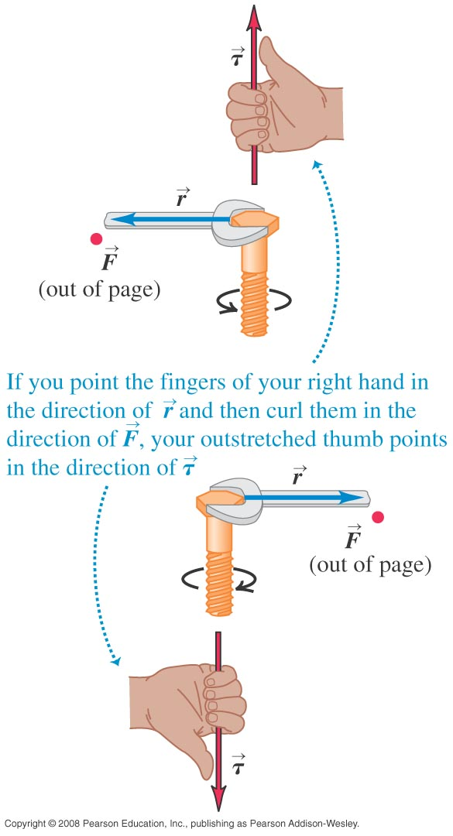
Torque as a vector
Torque can be expressed as a vector using the vector product.
Figure at the right shows how to find the direction of torque using a right hand rule.

Slide 5

Torque as a vector

Slide 6
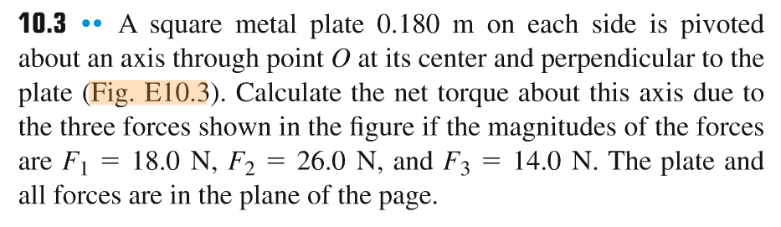
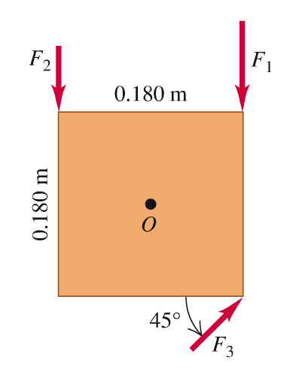
Problem #1

Slide 7
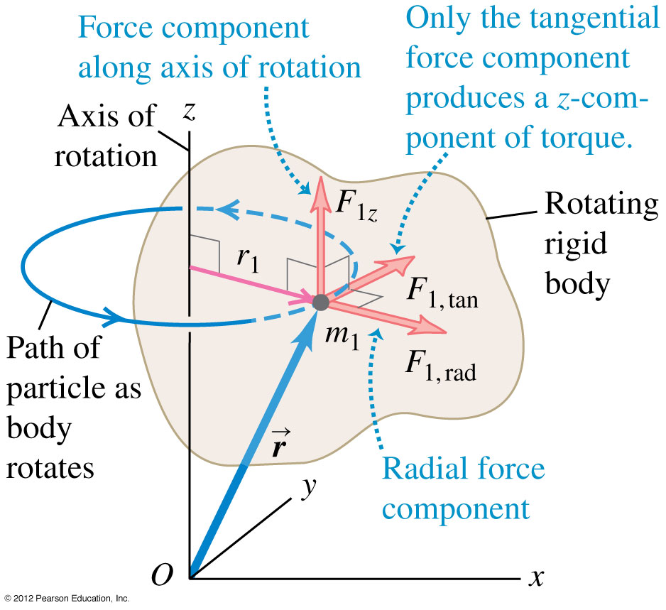

Torque and angular acceleration for a rigid body
The rotational analog of Newton’s second law for a rigid body

Slide 8
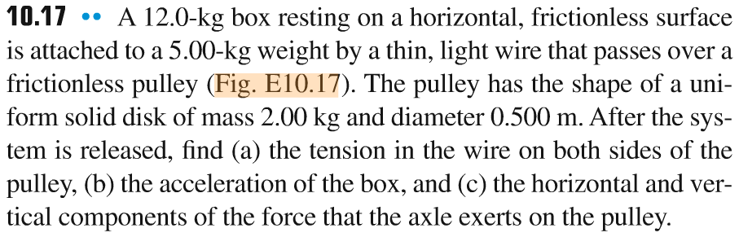
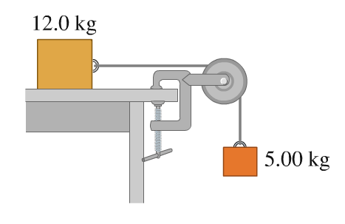
Problem #2

Slide 9
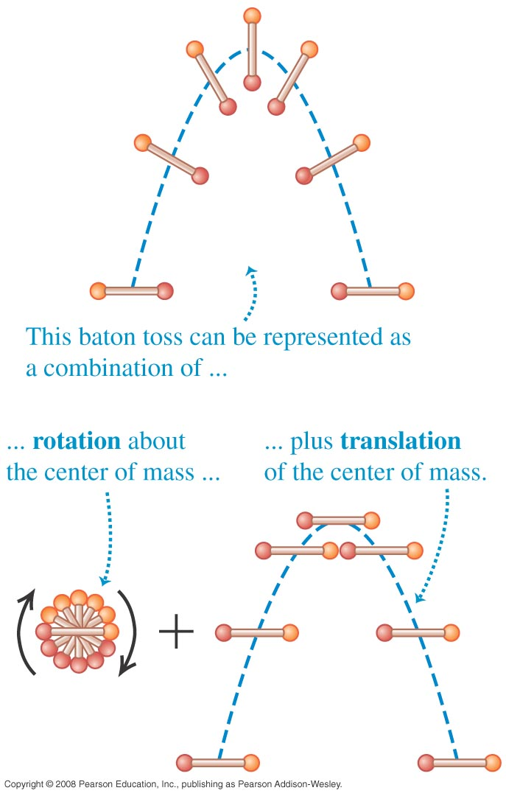
Rigid body rotation about a moving axis
The motion of a rigid body is a combination of translational motion of the center of mass and rotation about the center of mass.
The kinetic energy of a rotating and translating rigid body is K = 1/2 Mv_{cm}² + 1/2 I_{cm}ω².

Slide 10
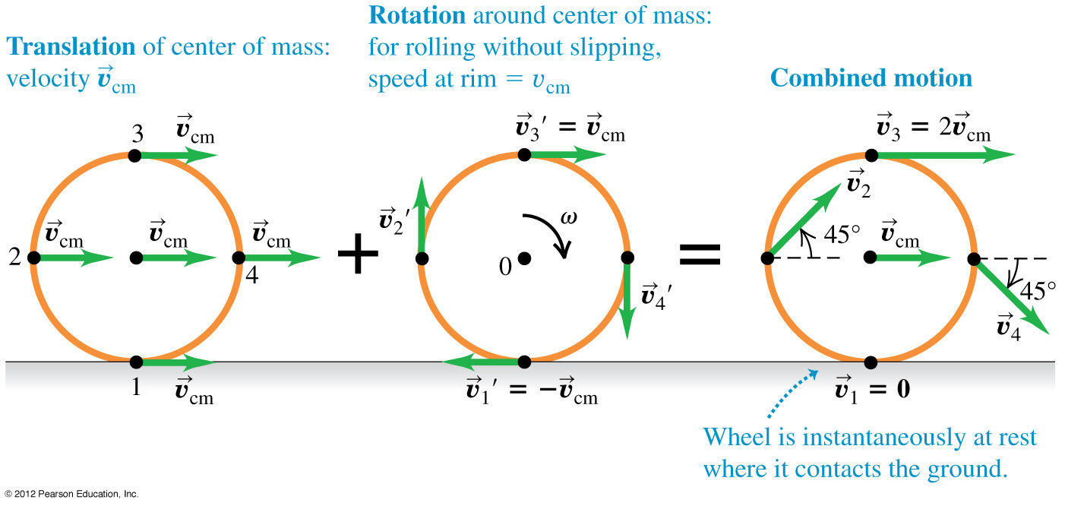
Rolling without slipping
The condition for rolling without slipping is v_{cm} = Rω.
Figure shows the combined motion of points on a rolling wheel.

Slide 11
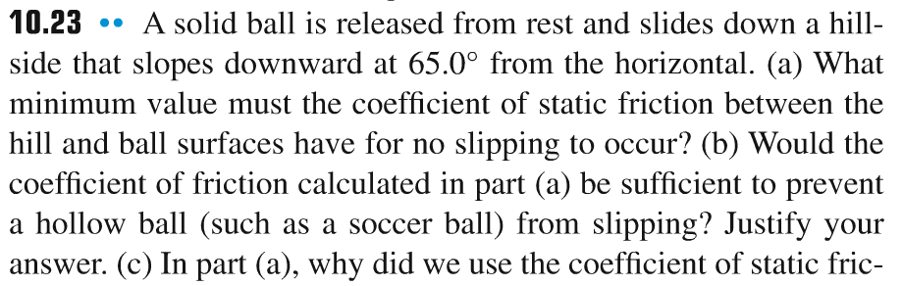
Problem #3

Slide 12
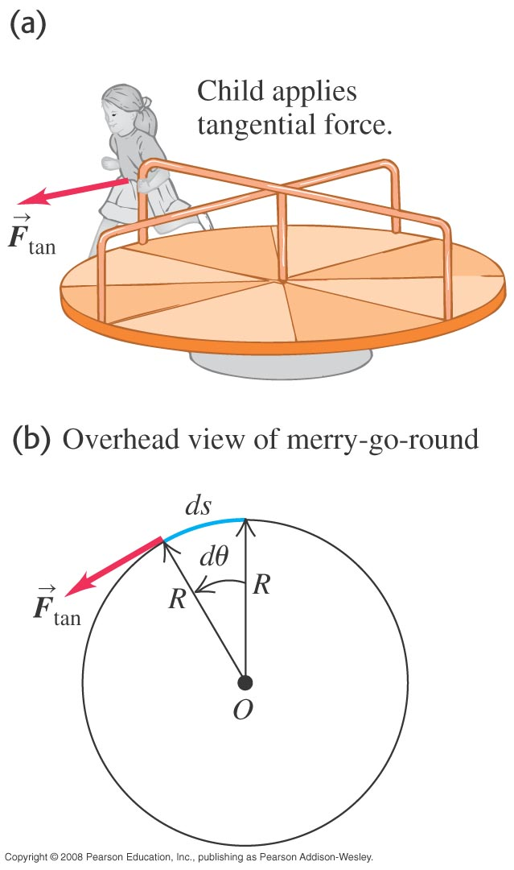
Work and power in rotational motion
Figure below shows that a tangential force applied to a rotating body does work on it.
The total work done on a body by the torque is equal to the change in rotational kinetic energy of the body and the power due to a torque is P = τ_{z}ω_{z}.

Slide 13
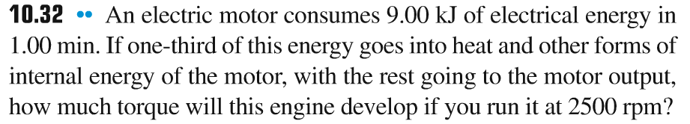
Problem #4

Slide 14
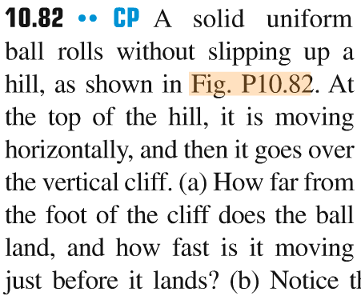
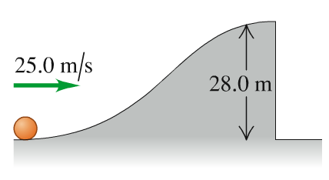
Problem #5

Slide 15
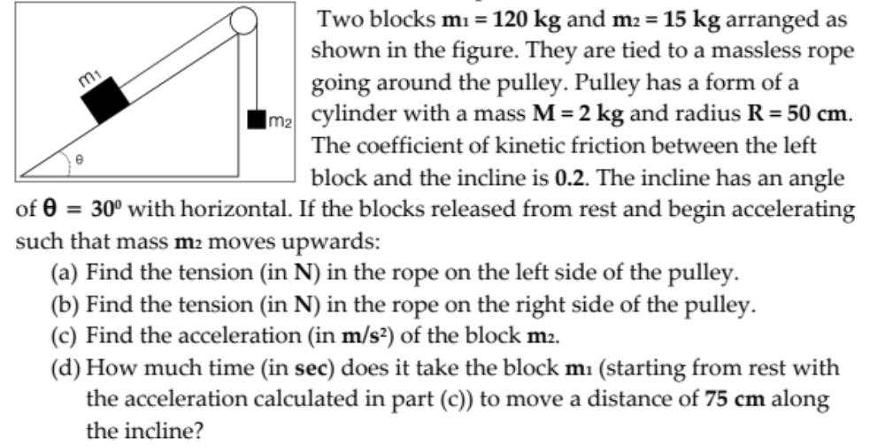
Problem #6

